Slide 1
Day 1 Coach Standup
[Date]

Slide 2

Coach Standup + Retro
Review individual and collective team progress
Capture challenge, content, technical, and program feedback
Measure productivity and adapt together as a team to stay on track
Address logistics and other housekeeping items

Slide 3
Standup Best Practices (Guiding Principles)
Run an end of day summary ‘team standup’ before our ‘coach standup’
Report on bugs, challenging concepts, feedback, highlights, insights, pain points, & workarounds (ensure to track extensively in COACH PORTAL)
Prepare a 1-2 min synopsis of your team’s feedback & findings for EOD coach standup
All bugs matter – even if the feedback has been submitted before!

Slide 4
Coach Team Assignments – [Topic]
add more/less rows depending on # of coaches
Coach Name | Team #
Tech Lead: [Name]
Current registrations: [#] regs = [#] teams

Slide 5
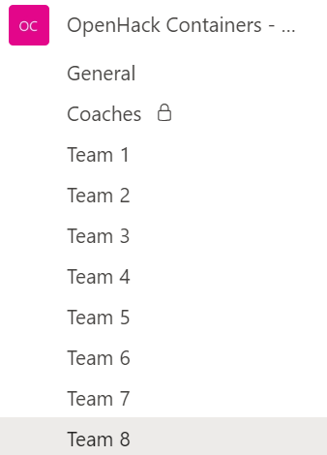
Teams for Participants
insert snip of actual teams channel
The Team
The Project Lead will tag participants to your team's channel the day before the OpenHack

Slide 6
Getting Your Team Started
Introductions
Validate participants match your confirmed team
Log into attendee portal (using the team's skillmeup email)
Confirm that participants completed prerequisites and all machines are ready to go
Remind your team of the working agreement (i.e. camera / audio on, breaks, etc.)

Slide 7
Challenge Best Practices
Begin each challenge by reading the challenge content thoroughly and then studying the success criteria as a team to identify MVP before jumping in
Run a retrospective at the end of each challenge to ensure your team grasps key concepts and learning objectives before moving on
Suggest breakout tech sessions or lead team where necessary for challenging concepts

Slide 8
Coach Resources
Coaches Guide will include resources such as:
Team assignments
Guidance on managing your team’s channel
Submitting feedback
Participant survey link
Opsgility portal coach guide
Other Coach-specific resources will be posted to Files under the Coaches channel
Success Matrix

Slide 9
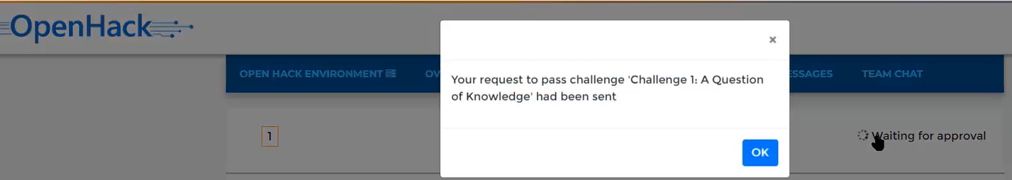
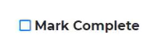
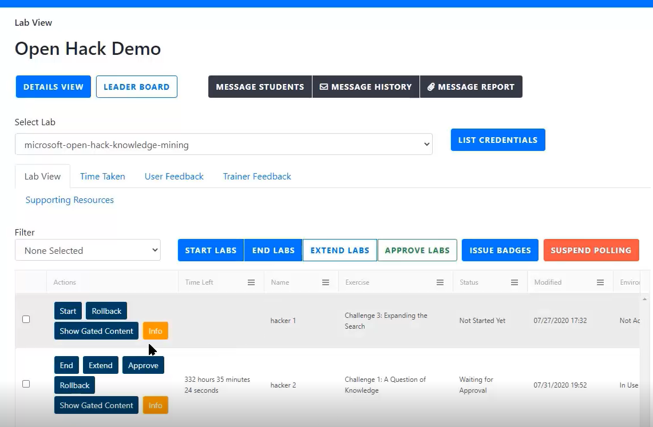
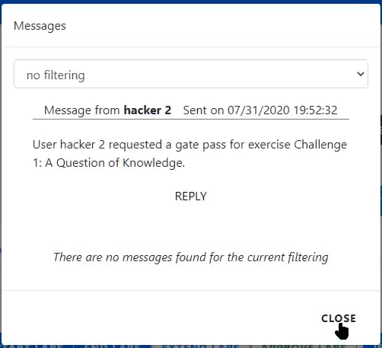
How to approve your team to next challenge
1. A team will indicate they have completed the Challenge in the attendee portal.
2. In the Lab View tab coaches will get pop-up notifications when a team has requested approval for the next challenge
3. By default all teams, available actions, and status will be listed. Find your team using the Name column. Select Approve once you validate your team’s progress.
Note: you can filter the messages from your team with the ‘Filter’ dropdown.

Slide 10
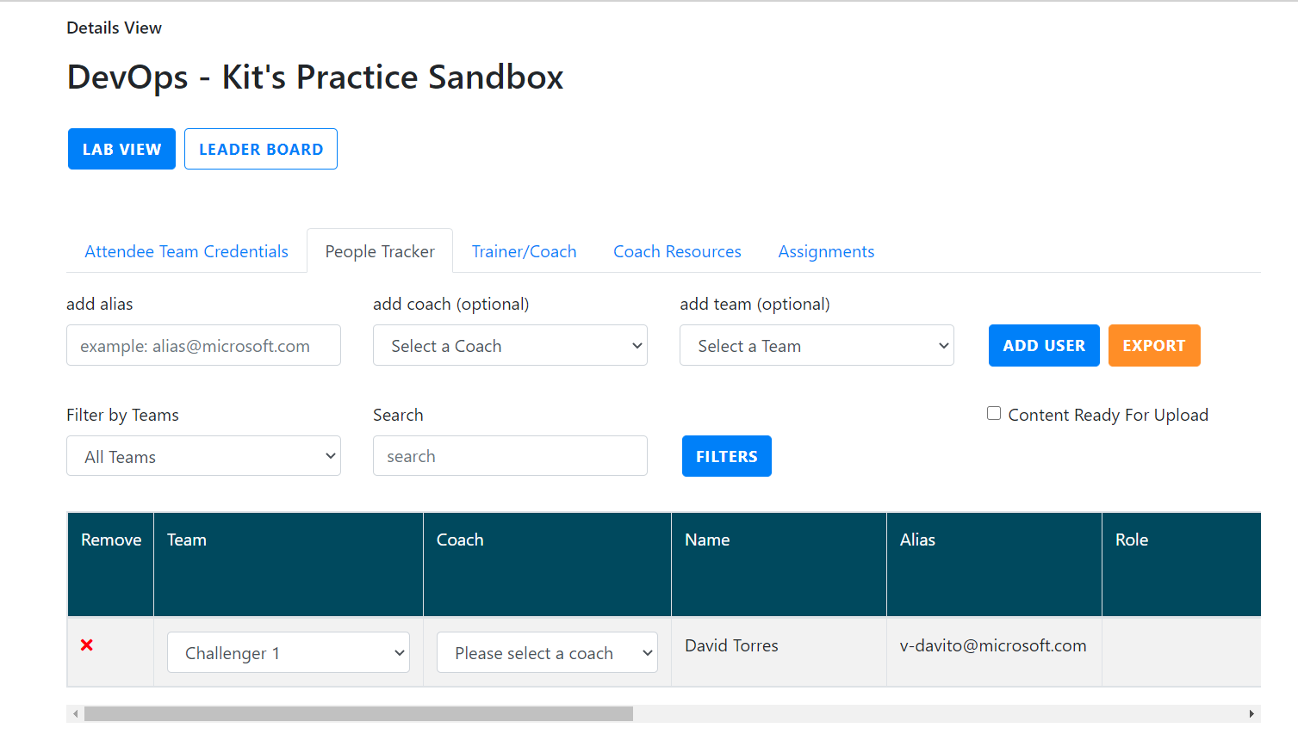
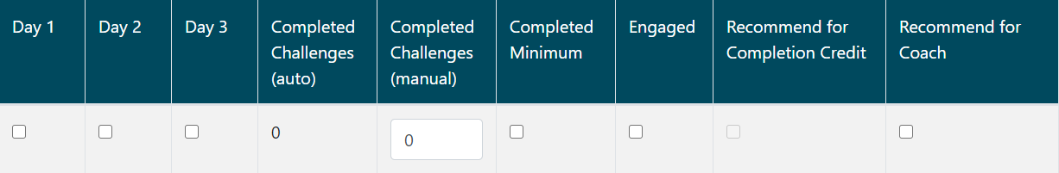
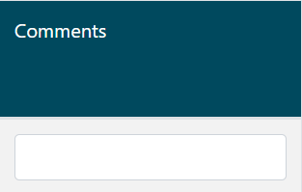
People tracker
3. Enter data for all fields in the people tracker. Note that all fields are necessary.
1. In the Details view tab use the People Tracker to capture all OpenHack TSI mandatory requirements.
2. First, add the Microsoft alias of the attendees on your team to using the Add User button. Select your team number and yourself as a coach for EACH user added.
Team | Assign the correct team number to attendee
Coach | Add the respective coach assigned to attendee
Name | Auto populated based on alias entry
Alias | Auto populated based on alias entry
Days | Validate attendance EVERY DAY of the OpenHack
Complete Challenges (auto) | Auto filled based progress in attendee portal
Completed Challenges (manual) | Requires coaches to manually add the actual challenge complete as this may not be uniform for all team members in case some teammates leave early
Engaged | Check if attendee was engaged
Recommended for Completion Credit | IMPT! Auto populated base on all other fields being completed. This is what determines TSI recommendation
Recommended for Coach | Check IF attendee is recommended to be a future coach.
Comments | A comment is required if a person is NOT being recommended for TSI completion.

Slide 11
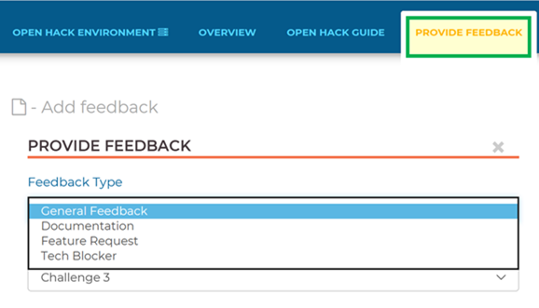
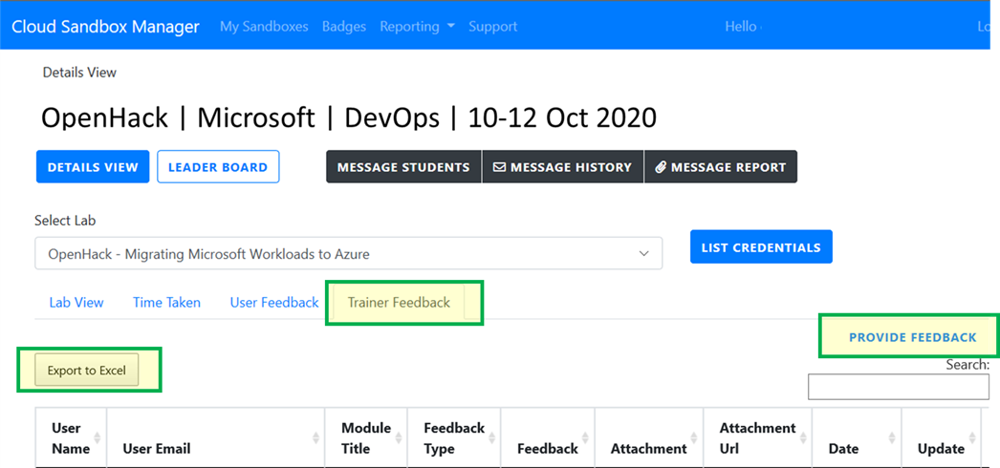
Submitting Feedback
Participant feedback is captured in the final attendee classroom environment in the 'Provide Feedback’ tab.
Coach feedback is captured in the OpenHack classroom admin portal in the Lab view tab 'Trainer Feedback'.

Slide 12
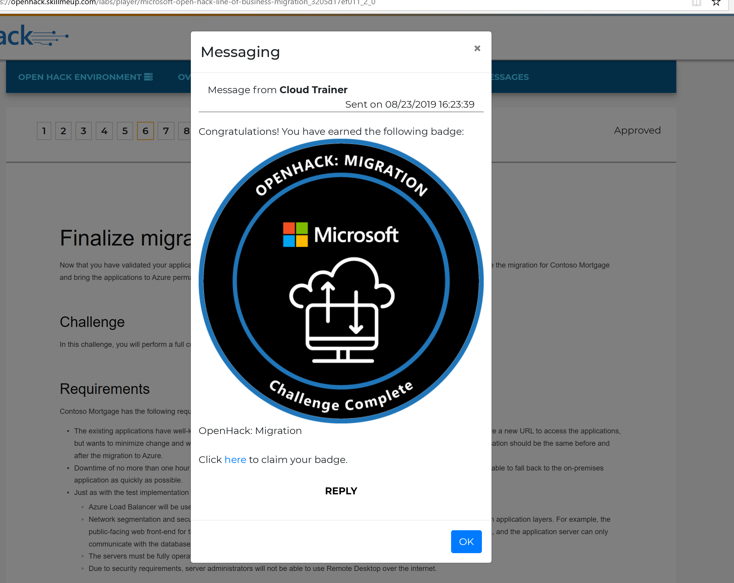
Issuing badges
Attendee badges are awarded automatically.
The badge is awarded upon completion of a challenge level that implies the attendee has sufficient understanding of the OH material.
When the coach approves the correlating challenge level as completed the attendee will receive a pop-up in their portal alerting them to claim their badge.
If users see an error when trying to claim their badge, the most common reason is that users need to log in again with their team’s skillmeup credential before they can input their personal acclaim details.
Coach, Tech Lead, and Project Lead badges are awarded manually.
To claim a coach badge fill out the form found at:
aka.ms/OHCoachBadge​
Badges are sent 1-2 weeks after filling out the form
More details here: OpenHack Badging Overview
Please email AskOpenHack@microsoft.com to claim any badges after the OpenHack. ​

Slide 13
Coach Resources
Resource | Link
Opsgility Portal User Guide | aka.ms/CoachPortalGuide
OpenHack Playbook Coach Page | aka.ms/OpenHackPlaybook
Coach solutions guides | aka.ms/OHCoachMaterials
Coach Ready training video (TSI) | aka.ms/ohcr
OpenHack Badging Overview | aka.ms/OHBadgesOverview

Slide 14
Today’s Afternoon Standup
[Start Time – End Time]
Come prepared with summary from your team:
Technical Feedback (product, documentation, feature, blocker)
Challenge Content Feedback
Progress
Workarounds
Interesting Approaches
Etc.

Slide 15
Questions?

Slide 16
Day 2 Coach Standup
[Date]

Slide 17
Reminders
Success Matrix
Completing a challenge requires 80% passing of core learning objectives
Ensure badges are issued / claimed
Challenge 6 (Leveraging PaaS services)
Ensure all feedback is captured
Remind your team of working agreement (i.e. camera/audio on, breaks, etc.)

Slide 18
Challenge Best Practices
Begin each challenge by reading the challenge content thoroughly and then studying the success criteria as a team to identify MVP before jumping in
Run a retrospective at the end of each challenge to ensure your team grasps key concepts and learning objectives before moving on
Suggest breakout tech sessions or lead team where necessary for challenging concepts

Slide 19
Coach Resources
Coaches Guide will include resources such as:
Team assignments
Guidance on managing your team’s channel
Submitting feedback
Participant survey link
Opsgility portal coach guide
Other Coach-specific resources will be posted to Files under the Coaches channel
Success Matrix

Slide 20
How to approve your team to next challenge
1. A team will indicate they have completed the Challenge in the attendee portal.
2. In the Lab View tab coaches will get pop-up notifications when a team has requested approval for the next challenge
3. By default all teams, available actions, and status will be listed. Find your team using the Name column. Select Approve once you validate your team’s progress.
Note: you can filter the messages from your team with the ‘Filter’ dropdown.

Slide 21
People tracker
3. Enter data for all fields in the people tracker. Note that all fields are necessary.
1. In the Details view tab use the People Tracker to capture all OpenHack TSI mandatory requirements.
2. First, add the Microsoft alias of the attendees on your team to using the Add User button. Select your team number and yourself as a coach for EACH user added.
Team | Assign the correct team number to attendee
Coach | Add the respective coach assigned to attendee
Name | Auto populated based on alias entry
Alias | Auto populated based on alias entry
Days | Validate attendance EVERY DAY of the OpenHack
Complete Challenges (auto) | Auto filled based progress in attendee portal
Completed Challenges (manual) | Requires coaches to manually add the actual challenge complete as this may not be uniform for all team members in case some teammates leave early
Engaged | Check if attendee was engaged
Recommended for Completion Credit | IMPT! Auto populated base on all other fields being completed. This is what determines TSI recommendation
Recommended for Coach | Check IF attendee is recommended to be a future coach.
Comments | A comment is required if a person is NOT being recommended for TSI completion.

Slide 22
Submitting Feedback
Participant feedback is captured in the final attendee classroom environment in the 'Provide Feedback’ tab.
Coach feedback is captured in the OpenHack classroom admin portal in the Lab view tab 'Trainer Feedback'.

Slide 23
Issuing badges
Attendee badges are awarded automatically.
The badge is awarded upon completion of a challenge level that implies the attendee has sufficient understanding of the OH material.
When the coach approves the correlating challenge level as completed the attendee will receive a pop-up in their portal alerting them to claim their badge.
If users see an error when trying to claim their badge, the most common reason is that users need to log in again with their team’s skillmeup credential before they can input their personal acclaim details.
Coach, Tech Lead, and Project Lead badges are awarded manually.
To claim a coach badge fill out the form found at:
aka.ms/OHCoachBadge​
Badges are sent 1-2 weeks after filling out the form
More details here: OpenHack Badging Overview
Please email AskOpenHack@microsoft.com to claim any badges after the OpenHack. ​

Slide 24
Coach Resources
Resource | Link
Opsgility Portal User Guide | aka.ms/CoachPortalGuide
OpenHack Playbook Coach Page | aka.ms/OpenHackPlaybook
Coach solutions guides | aka.ms/OHCoachMaterials
Coach Ready training video (TSI) | aka.ms/ohcr
OpenHack Badging Overview | aka.ms/OHBadgesOverview

Slide 25
Today’s Afternoon Standup
[Start Time – End Time]
Come prepared with summary from your team:
Technical Feedback (product, documentation, feature, blocker)
Challenge Content Feedback
Progress
Workarounds
Interesting Approaches
Etc.

Slide 26
Questions?

Slide 27
Day 3 Coach Standup
[Date]

Slide 28
Survey
Before starting today have each team member complete a brief survey
[insert shortlink to survey]

Slide 29
Reminders
Success Matrix
Completing a challenge requires 80% passing of core learning objectives
Ensure badges are issued / claimed
Challenge 6 (Leveraging PaaS services)
Ensure all feedback is captured
Remind your team of working agreement (i.e. camera/audio on, breaks, etc.)

Slide 30
Challenge Best Practices
Begin each challenge by reading the challenge content thoroughly and then studying the success criteria as a team to identify MVP before jumping in
Run a retrospective at the end of each challenge to ensure your team grasps key concepts and learning objectives before moving on
Suggest breakout tech sessions or lead team where necessary for challenging concepts

Slide 31
Coach Resources
Coaches Guide will include resources such as:
Team assignments
Guidance on managing your team’s channel
Submitting feedback
Participant survey link
Opsgility portal coach guide
Other Coach-specific resources will be posted to Files under the Coaches channel
Success Matrix

Slide 32
How to approve your team to next challenge
1. A team will indicate they have completed the Challenge in the attendee portal.
2. In the Lab View tab coaches will get pop-up notifications when a team has requested approval for the next challenge
3. By default all teams, available actions, and status will be listed. Find your team using the Name column. Select Approve once you validate your team’s progress.
Note: you can filter the messages from your team with the ‘Filter’ dropdown.

Slide 33
People tracker
3. Enter data for all fields in the people tracker. Note that all fields are necessary.
1. In the Details view tab use the People Tracker to capture all OpenHack TSI mandatory requirements.
2. First, add the Microsoft alias of the attendees on your team to using the Add User button. Select your team number and yourself as a coach for EACH user added.
Team | Assign the correct team number to attendee
Coach | Add the respective coach assigned to attendee
Name | Auto populated based on alias entry
Alias | Auto populated based on alias entry
Days | Validate attendance EVERY DAY of the OpenHack
Complete Challenges (auto) | Auto filled based progress in attendee portal
Completed Challenges (manual) | Requires coaches to manually add the actual challenge complete as this may not be uniform for all team members in case some teammates leave early
Engaged | Check if attendee was engaged
Recommended for Completion Credit | IMPT! Auto populated base on all other fields being completed. This is what determines TSI recommendation
Recommended for Coach | Check IF attendee is recommended to be a future coach.
Comments | A comment is required if a person is NOT being recommended for TSI completion.

Slide 34
Submitting Feedback
Participant feedback is captured in the final attendee classroom environment in the 'Provide Feedback’ tab.
Coach feedback is captured in the OpenHack classroom admin portal in the Lab view tab 'Trainer Feedback'.

Slide 35
Issuing badges
Attendee badges are awarded automatically.
The badge is awarded upon completion of a challenge level that implies the attendee has sufficient understanding of the OH material.
When the coach approves the correlating challenge level as completed the attendee will receive a pop-up in their portal alerting them to claim their badge.
If users see an error when trying to claim their badge, the most common reason is that users need to log in again with their team’s skillmeup credential before they can input their personal acclaim details.
Coach, Tech Lead, and Project Lead badges are awarded manually.
To claim a coach badge fill out the form found at:
aka.ms/OHCoachBadge​
Badges are sent 1-2 weeks after filling out the form
More details here: OpenHack Badging Overview
Please email AskOpenHack@microsoft.com to claim any badges after the OpenHack. ​

Slide 36
Coach Resources
Resource | Link
Opsgility Portal User Guide | aka.ms/CoachPortalGuide
OpenHack Playbook Coach Page | aka.ms/OpenHackPlaybook
Coach solutions guides | aka.ms/OHCoachMaterials
Coach Ready training video (TSI) | aka.ms/ohcr
OpenHack Badging Overview | aka.ms/OHBadgesOverview

Slide 37
Today’s Afternoon Standup
[Start Time – End Time]
Come prepared with summary from your team:
Technical Feedback (product, documentation, feature, blocker)
Challenge Content Feedback
Progress
Workarounds
Interesting Approaches
Etc.

Slide 38
Questions?

